Slide 1
Module 4
Semantic Analysis

Slide 2
Content
Lexical Semantics
Ambiguous words
Word senses
Relations between senses: synonym,antonym,, hyponym, hypernym, meronym, structured polysemy
Introduction to WordNet, gloss, synset, sense relations in WordNet.
Cosine distance between documents.
Word sense disambiguation.

Slide 3
Introduction
Semantic analysis is the process of extracting meaning from text.
It permits computers to know and interpret sentences, paragraphs, or whole documents.
It is done by analysing their grammatical structure, and distinguishing relationships between
individual words in a specific context.
It’s an important sub-task of Natural Language Processing (NLP).
It drives machine learning tools like chatbots, search engines, and text analysis.
Semantic analysis-driven tools can facilitate industries to automatically extract meaningful
information from unstructured data, like emails, comments, and feedback.

Slide 4
Parts of semantic Analysis
Semantic Analysis of Natural Language can be classified into two broad parts:
1. Lexical Semantic Analysis: Lexical Semantic Analysis involves understanding the meaning of each word of the text individually. It basically refers to fetching the dictionary meaning that a word in the text is deputed to carry.
2. Compositional Semantics Analysis: Although knowing the meaning of each word of the text is essential, it is not sufficient to completely understand the meaning of the text.
For example, consider the following two sentences:
Sentence 1: Students love CRCE.
Sentence 2: CRCE loves Students.
Although both these sentences 1 and 2 use the same set of root words {student, love, CRCE}, they convey entirely different meanings.
Hence, under Compositional Semantics Analysis, we try to understand how combinations of individual words form the meaning of the text.

Slide 5
Example : "Your customer service is a joke! I've been on hold for 30 minutes and counting!"
a. Any human can understand that a customer is frustrated because a customer service agent is taking too long to respond.
b. However, machines first need to be trained to make sense of human language and understand the context in which words are used
c. Otherwise, they might misinterpret the word “joke” as positive.

Slide 6
Lexical Semantics
Lexical semantics plays a crucial role in semantic analysis, allowing computers to know
relationships between words, phrasal verbs, etc.
In Lexical Semantics words, sub-words, etc. are called lexical items.
In simple terms, lexical semantics is the relationship between lexical items, meaning of
sentences and syntax of sentence.
Lexical semantics includes the following two main points :
a. Classification and Decomposition of lexical items.
b. Analyze the differences and similarities between numerous lexical-semantic structures.

Slide 7
Ambiguity and word senses
Semantic ambiguity happens when the word themselves have a variable meaning.
Take the below example, The car hit the pole while it was moving.
The interpretation can be
The car (while moving) hit the pole
The car hit the pole that was moving.
The first interpretation is preferred over the second one because we have a model of the world that help us to distinguish what is logical (or possible) from what is not.

Slide 8
Word Sense
A sense (or word sense) is a discrete representation of one aspect of the meaning of a word.
Generally, we represent each sense with a sub script.
Bank¹ and bank², mouse¹ and mouse².
In context , its easy to see the different meanings:
Mouse¹ : A mouse controlling a computer system.
Mouse²: a quite animal like mouse

Slide 9
Relations between senses: (IMP)
Synonym
Antonym
Hyponym
Hypernym
Meronym
Metonymy

Slide 10
Synonyms :
They are words that have the same sense or mostly the same meaning as another, e.g., sad, unhappy, depressed, etc. When two lexical items may be swapped out for one another in a sentence without changing its meaning or acceptability, the words are said to be synonyms.
Example:
How big is that plane?
Would I be flying on a ‘large’ or a ‘small’ plane.
Exchanging big and large in these examples has no noticiable effect on the meaning of the sentence.

Slide 11
Antonyms :
They are words that have close to opposite meanings e.g., good, bad.
An antonym occurs when two or more lexemes have opposite meaning from one another.
Two senses can be antonyms if they define a binary opposition or are at opposite ends of some scale
Example: Good – bad, Big – small, Fast – Slow
Complementary pairs: Refers to the existence of pairs that the deniel of one, implies assertion of other.
Example : Male-Female, Alive-Dead, Present – Absent
Another group of antonyms, reversives, describe change or movement in opposite directions, such as rise/fall or up/down

Slide 12
Hoponym (Class-object)
Hyponymys refers to a term that is an instance of a generic term.
They can be understood by taking class-object as an analogy. For example: ‘Color‘ is a hypernymy while ‘grey‘, ‘blue‘, ‘red‘, etc, are its hyponyms.
Another example is ‘car’ is a hyponym of ‘vehicle’
dog is a hyponym of animal
mango is a hyponym of fruit

Slide 13
Hypernyms (Class-Object)
Hypernym is a term whose meaning includes the meaning of other words, its a broad superordinate label that applies to many other members of set. .
For example, Fruit is a hypernym for mango, Banana etc. or
Hypernym is the sense which is a superclass :
i. vehicle is a hypernym of car
ii. animal is a hypernym of dog

Slide 14
Hypernymy and Hyponymy
In simpler terms, a hyponym is in a type-of relationship with its hypernym.
• Hypernyms and hyponyms are asymmetric.
• Hyponymy can be tested by substituting X and Y in the sentence "X is a kind of Y" and
determining if it makes sense.
• For example, "A screwdriver is a kind of tool" makes sense, but not "A tool is a kind of
screwdriver".
• Strictly speaking, the meaning relation between hyponyms and hypernyms applies to
lexical items of the same word class (or parts of speech), and holds between senses rather
than words.
• Hyponymy is a transitive relation, if X is a hyponym of Y, and Y is a hyponym of Z, then X
is a hyponym of Z.
• For example, violet is a hyponym of purple and purple is a hyponym of color ; therefore,
violet is a hyponym of color.

Slide 15
Hypernymy and Hyponymy
They could be observed from top to bottom, where the higher level is more general and
the lower level is more specific.
• Hyponymy is the most frequently encoded relation among synsets used in lexical
databases such as WordNet.

Slide 16
Homonyms
Homonymy refers to two or more lexical terms with the same spellings but completely distinct in meaning.
For example: ‘Rose‘ might mean ‘the past form of rise‘ or ‘a flower‘, – same spelling but different meanings; hence, ‘rose‘ is a homonymy. e.g., right (correct), right (turn).
bat (wooden stick thing) vs bat (flying scary mammal)
bank (financial institution) vs bank (riverside)

Slide 17
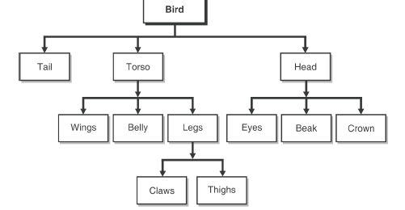
Meronomy (part-to-whole relation)
A Meronym in semantic is a word that designates a component or a member of something.
For example, apple is a meronym of apple tree (sometimes written as apple -> apple tree)
The part-to-whole relationship is called meronym.
Wheel‘ is a meronym of ‘Automobile.

Slide 18
Polysemy
Polysemy is a relationship between the meanings of words or phrases, although slightly different, they share a common basic meaning
E.g. Polysemy refers to lexical terms that have the same spelling but multiple closely related meanings. It differs from homonymy because the meanings of the terms need not be closely related in the case of homonymy.
For example: ‘man‘ may mean ‘the human species‘ or ‘a male human‘ or ‘an adult male human‘ – since all these different meanings bear a close association, the lexical term ‘man‘ is a polysemy.
Bank- bank could be a river bank or financial organization

Slide 19
Polysemy
i. He drank a glass of milk.
ii. He forgot to milk the cow.
iii. The enraged actor sued the newspaper.
iv. He read the newspaper.

Slide 20
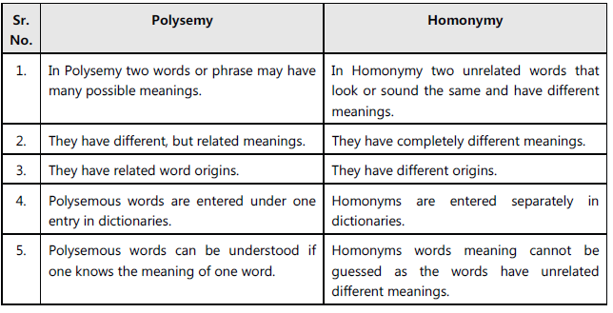
Difference between Polysemy and Homonymy

Slide 21
Metonymy
Metonymy is a figure of speech in which the name of one item is substituted for the name of another to which it is related or to which it is an attribute.
Example:
Using crown for King/Queen : The land belonging to the ‘crown’
Using the white House for the US president – The White House today will announce the secret first hand.

Slide 22
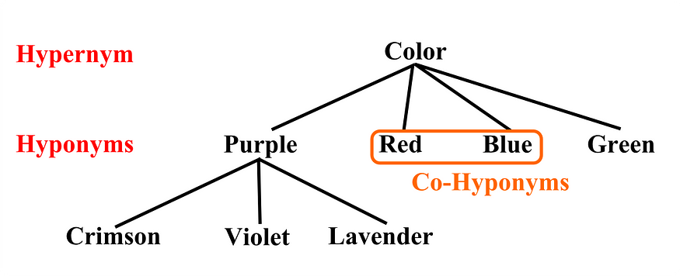

Slide 23
Introduction to WordNet
Automatically interpreting and analysing the meaning of words and pre-processing textual input can be complex in Natural Language Processing (NLP).
We frequently employ lexicons to help with this.
We frequently link the text in our data to the lexicon, which aids us in comprehending the relationships between those terms.
WordNet is one such lexical resource.
Its unique semantic network aids in the discovery of word relationships, synonyms, grammar, and other topics. This aids NLP tasks like sentiment analysis, automatic language translation, and text similarity.

Slide 24
WordNet
WordNet is a large lexical database of words, senses, and their semantic relations.
In WordNet, the sense is defined by a set of synonyms, called sysnets, that have a similar meaning or sense. This means WordNet represents words (or senses) as lists of the word senses that can be used to express the concept.
Here is an example of synset. Sense for the word 'fool' can be defined by the list of synonyms as {chump, jester, gull, fritter, dupe, fool around}
The English WordNet consists of three separate databases, one each for nouns and verbs and a third for adjectives and adverbs.
There are several lemmas in each database, and each one is labeled with several senses.
There are 117798 nouns, 11529 verbs, 22479 adjectives and 4481 adverbs in wordNet 30 release.

Slide 25
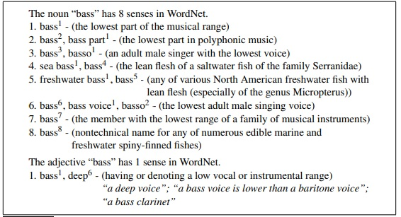
Figure shows the lemma entry for the noun and adjective bass.
Note that there are eight senses for the noun and one for the adjective, each of gloss which has a gloss (a dictionary-style definition), a list of synonyms for the sense, and sometimes also usage examples (shown for the adjective sense). Unlike dictionaries, WordNet doesn’t represent pronunciation, so doesn’t distinguish the pronunciation [b ae s] in bass4 , bass5 , and bass8 from the other senses pronounced [b ey s]

Slide 26
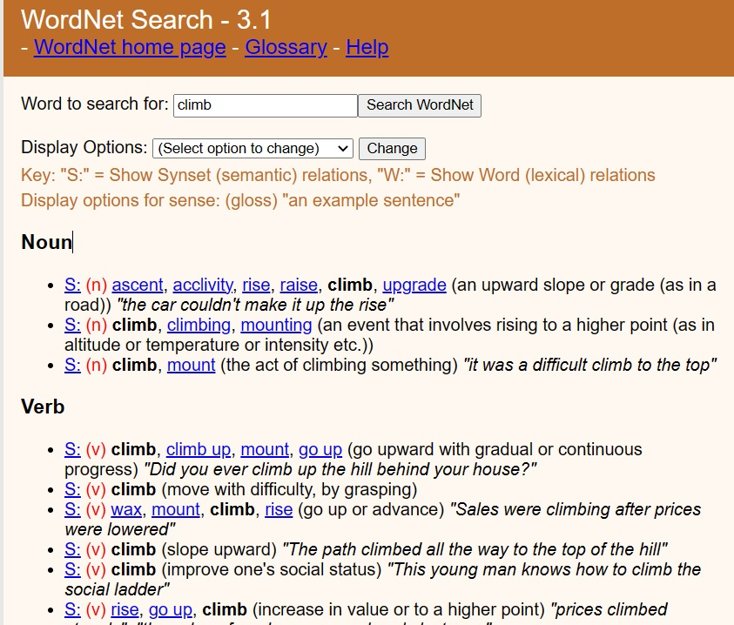

Slide 27
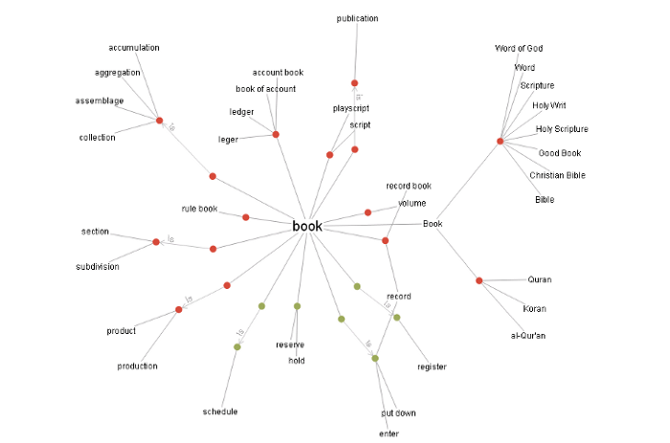

Slide 28
Gloss
The Glosses are textual definitions for each sense provided by dictionaries and thesauruses.
Glosses are properties of a synset, so that each sense included in the synset has the same gloss and can express this concept.
Here are the Glosses for two senses of ‘bank’
1. The financial institution that accepts deposits and channels the money into leading activities
2. Sloping land (especially the slope beside a body of water)
Glosses are not a formal meaning representation; they are just written for people.

Slide 29
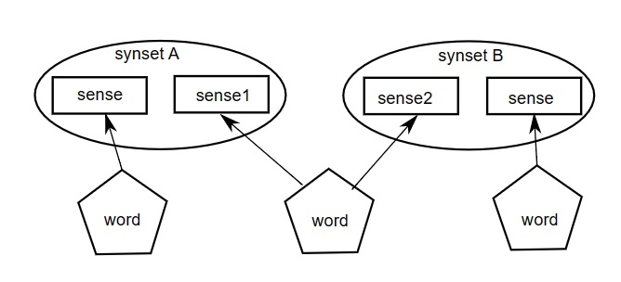
Synset
WordNet categorizes English words into synonyms, referred to as Synsets (short for a set of synonyms).
The set of near-synonyms for a WordNet sense is called a synset.
synsets are an important primitive in WordNet.\
Every Synset contains a name, a part-of-speech (nouns, verbs, adverbs, and adjectives), and a number.
Synsets are used to store synonyms, where each word in the Synset shares the same meaning. Essentially, each Synset is a collection of synonyms.
Some words have just one Synset, while others have multiple Synsets. Every Synset has a definition associated with it.
Synset makes it easier for users to look up words in the WordNet database.

Slide 30
The Structure of a Wordnet
A wordnet is an online lexicon which is organized by concepts.
The basic unit of a wordnet is the synonym set (synset), a group of words that all refer to the same concept.
Words and synsets are linked by means of conceptual-semantic relations to form the structure of wordnet.

Slide 31
Words, Senses, and Synsets
We all know that words are the basic building blocks of languages.
A word is built up with two parts, its form and its meaning.
But in natural languages, the word form and word meaning are not in an elegant one-to-one match, one word form may connect to many different meanings, so hereforth, we need senses, to work as the unit of word meanings, for example, the word ’bank’ has at least two senses:
bank¹: financial institution, like City Bank;
bank²: sloping land, like river bank;
Since synsets are group of words sharing the same concept, bank¹ and bank² are members of two different synsets, although they have the same word form.
On the other hand, different word forms may also convey the same concept, such as ’cab’ and ’taxi’, these word forms with the same concept are grouped together into one synset.

Slide 32
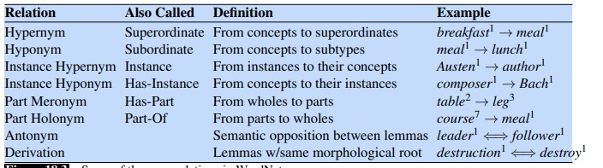
Sense Relations in WordNet
WordNet also represents relations between senses, like the IS-A relation between dog and mammal or the part-whole relationship between car and engine. WordNet represents all the kinds of sense relations discussed in the previous section (Synonym, antonym, Meronym….etc)
Some of the noun relations in WordNet.

Slide 33
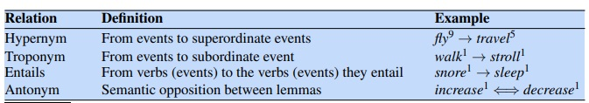
Some verb relations in WordNet.
For example WordNet represents hyponymy by relating each synset to its immediately more general and more specific synsets through direct hypernym and hyponym relations.
These relations can be followed to produce longer chains of more general or more specific synsets.

Slide 34
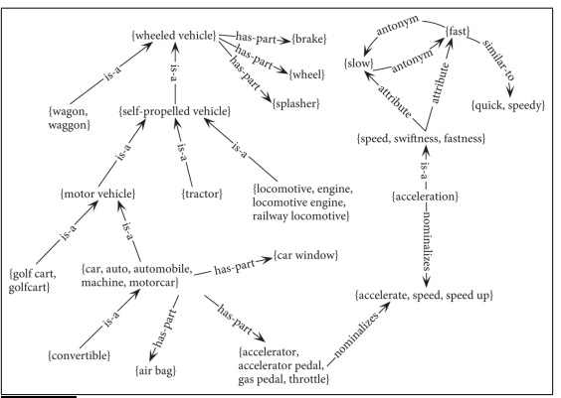
WordNet viewed as a graph

Slide 35
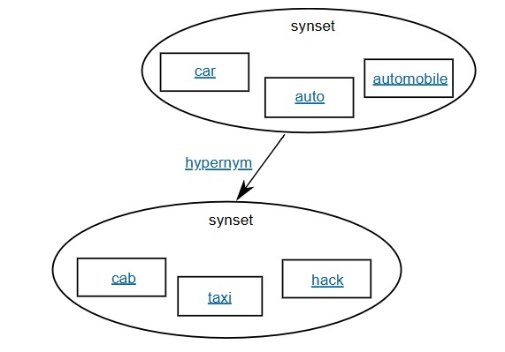
Synset Relations
In wordnet, synsets are linked with each other to form various kinds of relations.
For example, if the concept expressed by a synset is more general than a given synset, then it is in a hypernym relation with the given synset.
As shown in the figure, the synset with car, auto and automobile as its member is the hypernym of the other synset with cab, taxi and hack. Such relation which is built on the synset level is categorized as synset relations.

Slide 36
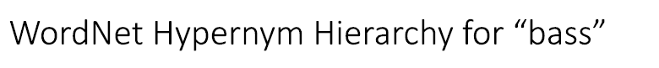

Slide 37
The Distinction Between WordNET and Thesaurus
Where thesaurus is helping us in finding the synonyms and antonyms of the words the WordNET is helping us to do more than that.
WordNET interlinks the specific sense of the words wherein thesaurus links words by their meaning only.
In the WordNET the words are semantically disambiguated if they are in close proximity to each other.
Thesaurus provides a level to the words in the network if the words have similar meaning but in the case of WordNET, we get levels of words according to their semantic relations which is a better way of grouping the words.

Slide 38
Cosine distance between documents
In NLP, calculating the similarity between two text documents is a popular task with a variety of real-world use. For example, text similarity can be used for ranking the results of a search engine or suggesting related content to readers.
What is Text Similarity?
Text Similarity is the process of comparing a piece of text with another and finding the similarity between them. It’s basically about determining the degree of closeness of the text.

Slide 39
Document/Text similarity can be used in…
Search engines need to model the relevance of a document to a query, beyond the overlap in words between the two. For instance, question-and-answer sites such as Quora or Stack Overflow need to determine whether a question has already been asked before.
Selecting the most similar product for a customer shopping in any online platform if that exact product is unavailable.
Checking similarity of multiple documents or letters.
Choosing the most appropriate or closest job role or profile a person’s resume.

Slide 40
Why text similarity is challenging. Let’s have a look at two sentences.
1. “The teacher gave his speech to an empty room”
2. “There was almost no body when the professor was talking”
Despite having an extremely similar meanings, they are spelled entirely differently. The only word shared by these two sentences is ‘the’.
We would like to have a sophisticated algorithm that returns a high similarity score for this pair of sentences.
Semantic text similarity is what we refer to when we want to calculate similarity based on the meaning.
Traditional text similarity algorithm only functions on a lexical level. Depending on the use case, they can offer better trade-off and are quicker and easy to implement.

Slide 41
To start with text similarity task, we need to convert the input text in a given document into a more machine-readable form by transforming the text into embeddings which then gets converted into vectors that are understood by the machine to calculate the similarity.
The objective is to create a vector space where, using a selected similarity metric, documents that are similar to one another are near.

Slide 42
Algorithms to transform the text into embeddings (or vectors)
1) Word count or frequency count method:
Using word count is the easiest method for creating a vector from a document.
Consider the following three sentences.
1. We went to the pizza place and you ate no pizza at all
2. I ate pizza with you yesterday at home
3. There’s no place like home.

Slide 43
To build the vector, we first count the occurrences of each word in a sentence.
Document 1 | Document2 | Document3
We – 1 | I – 1 | There’s – 1
Went -1 | Ate – 1 | No -1
To -1 | Pizza – 1 | Place -1
The – 1 | With -1 | Like -1
Pizza-2 | You – 1 | Home -1
Place - 1 | …. | ….
…. | ….
…

Slide 44
Numerical:
Given two documents
D1: “digital information is new technology”
D2: “digital technology changes the world”
Represent the above two documents in the form vector using word count method. Compute cosine similarity between the two documents.
Let D1 is represented by vector A= [1,2,1,1,1,0,0,0]
and D2 is represented by vector B = [1,0,0,0,1,1,1,1]
 | Digital | Information | Is | New | technology | Change | The | World
D1 | 1 | 2 | 1 | 1 | 1 | 0 | 0 | 0
D2 | 1 | 0 | 0 | 0 | 1 | 1 | 1 | 1

Slide 45
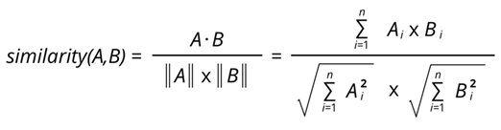
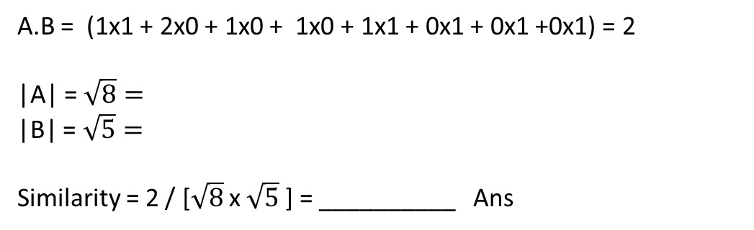
A= [1,2,1,1,1,0,0,0]
B = [1,0,0,0,1,1,1,1]
A.B = (1x1 + 2x0 + 1x0 + 1x0 + 1x1 + 0x1 + 0x1 +0x1) = 2
|A| = $\sqrt{8}=$
|B| = $\sqrt{5}=$
Similarity = 2 / [$\sqrt{8}$ x $\sqrt{5}$ ] = __________ Ans

Slide 46
2) TF-IDF method
The problem with the previous method(word count) is that all words in the phrase are treated with the same importance, there is no option to prioritize the words.
The most often used words like ‘the’, ‘an’, ‘is’, are the ones which are less important. These are the stop words. We can eliminate stop words in pre-processing step.
To overcome this problem, TF-IDF was introduced as a numeric approach that gives a certain importance measure to the word embeddings.

Slide 47
Term Frequency - Inverse Document Frequency (TF-IDF) is a widely used statistical method in natural language processing and information retrieval.
It measures how important a term is within a document relative to a collection of documents.
Words within a text document are transformed into importance numbers by a text vectorization process.
TF-IDF gets this importance score by multiplying the term’s frequency (TF) and the term inverse document frequency (IDF).
The higher the TF-IDF score the rarer the term in a document and the higher its importance.

Slide 48
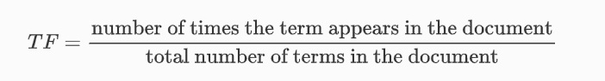
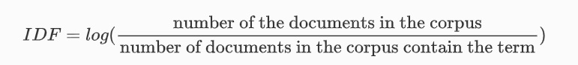
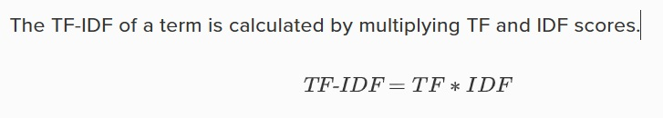
Term Frequency (TF) : TF of a term or word is the number of times the term appears in a document compared to the total number of words in the document.
Inverse Document Frequency (IDF):
IDF of a term reflects the proportion of documents in the corpus that contain the term. Words unique to a small percentage of documents (e.g., technical jargon terms) receive higher importance values than words common across all documents (e.g., a, the, and).

Slide 49
In simple language, Importance of a term is high when it occurs a lot in a given document and rarely in others. In short, commonality within a document measured by TF is balanced by rarity between documents measured by IDF. The resulting TF-IDF score reflects the importance of a term for a document in the corpus.

Slide 50
Numerical: TF-IDF
Idf (word) = log( N / [d €C :word € d] )
N – total number of documents in the corpus.
C – the corpus.
d – the number of documents in which the word appears.
For the previous example, if we consider three documents.
Doc 1 - We went to the pizza place and you ate no pizza at all
Doc 2 - I ate pizza with you yesterday at home
Doc 3 - There’s no place like home.
The word ‘Pizza’ will have IDF as
Log(3/2) = 0.4
And the word ‘yesterday’ will have an IDF as
Lod(3/1) = 1.1
For each word in our corpus, the IDF is calculated once as a preprocessing step and it will tell you how significant that word is inside the corpus.
At this point , we compute the document vectors by balancing it with the IDF rather than using the raw word counts.
The final score of each word can be calculated as,
Score(word) = frequency(word) x idf(word)

Slide 51
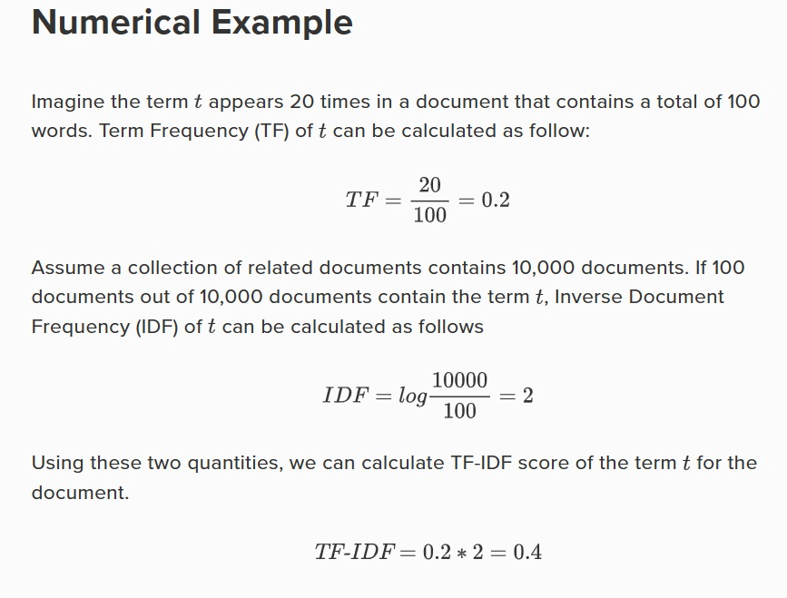

Slide 52
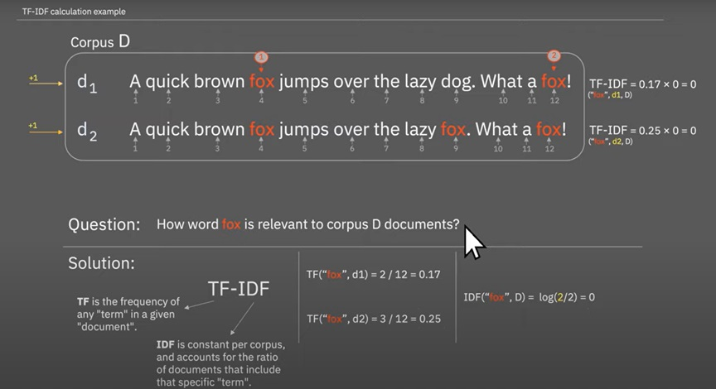
TF-IDF Numerical

Slide 53
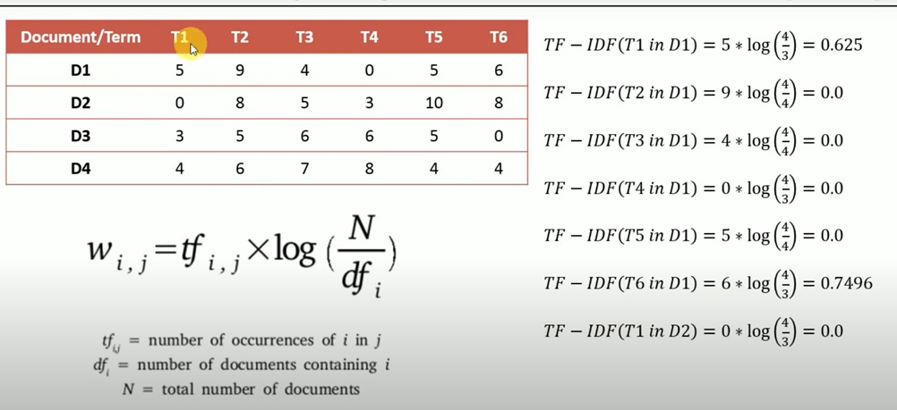
Example of TF-IDF calculation

Slide 54
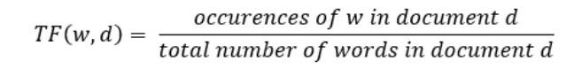
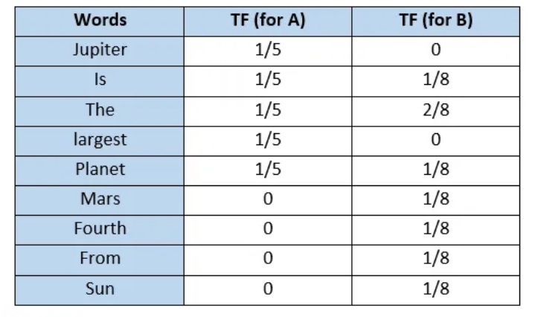
Given two documents
A : “Jupiter is the largest planet”
B: “Mars is the fourth planet form the earth”. Represent both the document in a vector form using TF-IDF
Step 1: Find TF (Term freq) for each term for each document in a corpus

Slide 55
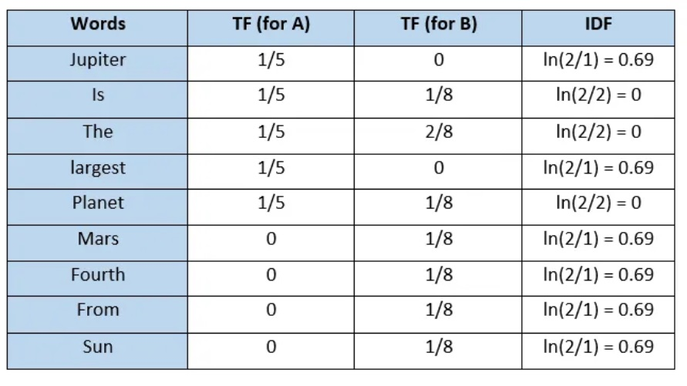
Step 2 : Calculate IDF for each term
IDF (w,C) = log ( Total number of documents in a given corpus C) / No. of documents containing w)

Slide 56
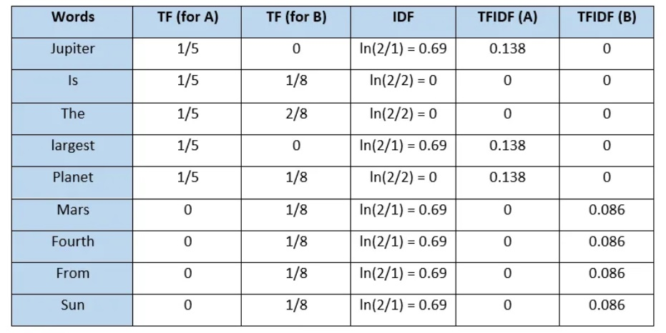
Step 3 – Calculate TF-IDF score for each term
TF –IDF (w,d,C) = TF(w,D) x IDF (w,C)
Vector representation of documents
A = [0.138,0,0,0.138,0.138,0,0,0,0]
B = [0,0,0,0,0,0.086, 0.086, 0.086, 0.086, 0.086]

Slide 57
Metrics to calculate the similarity between embeddings
Once we have our document vectors ready, we can use any similarity measure to find similarities between two documents.
Cosine similarity is the most commonly used one such measure.
Other measures are Jaccard Similarity and Euclidean Distance

Slide 58
Cosine similarity
Cosine similarity measures the similarity between two vectors of an inner product space in general.
It measures the cosine of the angle between two embeddings and determines whether they are pointing in roughly the same direction or not.
When the embeddings are pointing in the same direction the angle between them is zero so their cosine similarity is 1.
When the embeddings are perpendicular to each other the angle between them is 90 degrees and the cosine similarity is 0 finally when the angle between them is 180 degrees the cosine similarity is -1

Slide 59
Cosine Similarity ranges from 1 to -1, where 1 represents most similar and -1 represents least similar.
If we apply it to our example vectors we get
Similarity(doc1, doc2) = 0.45
Similarity(doc1, doc3) = 0.23
Similarity(doc2, doc3) = 0.15
We can say that, the first two documents resemble.

Slide 60
Problem based on IDF [Home Assignment]
We have a document database of five documents with the following content.
D1: “Information Retrieval System”
D2: “Information Storage”
D3: “Digital Speech Synthesis System”
D4: ”Speech filtering”
D5: “Speech retrieval”
Calculate Term frequency (TF) matrix.
Calculate inverse document frequency (IDF) for each term.
Calculate TF-IDF for the term “Speech” and explain how the term “Speech” is related to all the documents in a given corpus. Which document is most relevant to the term “Speech”?

Slide 61
Word sense disambiguation
The task of selecting the correct sense for a word is called word sense disambiguation, or WSD.
WSD algorithms take as input a word in context and a fixed inventory of potential word senses and, outputs the correct word sense in context.
The input and the senses, depend on the task.
For machine translation from English to Spanish, the sense tag inventory for an English word might be the set of different Spanish translations.
For automatic indexing of medical articles, the sense-tag inventory might be the set of MeSH (Medical Subject Headings) thesaurus entries.
There are mainly two WSD tasks: Lexical sample and all – word.
In the lexical sample task, a small pre-selected set of target words is chosen, along with an inventory of senses for each word from some lexicon. Since the set of words and the set of senses are small, simple supervised classification approaches are used.

Slide 62
In the all-words task, systems are given entire texts and a lexicon with an inventory of senses for each entry and are required to disambiguate every content word in the text.
The all-words task is similar to part-of-speech tagging, except with a much larger set of tags since each lemma has its own set.
A consequence of this larger set of tags is data sparseness; it is unlikely that adequate training data for every word in the test set will be available. Moreover, given the number of polysemous words in reasonably sized lexicons, approaches based on training one classifier per term are unlikely to be practical.

Slide 63
Approaches for Word Sense Disambiguation
Supervised Machine Learning
Unsupervised
Knowledge based or Dictionary based approach

Slide 64
Supervised
The Supervised method is based on a annotated data/ corpus.
The supervised approach is based on trained sense annotated corpus to build classifiers. Initially, annotated corpus is required to build a classifier.
The classifier is used to recognized the sense of the word based on their context of use. This approach assumes that the context can provide enough evidence on its own to disambiguate words.
A major disadvantage of this approach is he requirement of a large sense-tagged corpora.
The accuracy of the classifier depends on the size and the variety of the data incorporated in the corpus. Larger the corpus, better the results. The creation of corpus itself is a challenge in terms of time and money

Slide 65
Some common techniques used in supervised WSD include:
Decision list: A decision list is a set of rules that are used to assign a sense to a target word based on the context in which it appears.
Neural Network: Neural networks such as feedforward networks, recurrent neural networks, and transformer networks are used to model the context-sense relationship.
Support Vector Machines: SVM is a supervised machine learning algorithm used for classification and regression analysis.
Naive Bayes: Naive Bayes is a probabilistic algorithm that uses Bayes’ theorem to classify text into predefined categories.
Decision Trees: Decision Trees are a flowchart-like structure in which an internal node represents feature(or attribute), the branch represents a decision rule, and each leaf node represents the outcome.

Slide 66
Supervised WSD Exploiting Glosses: Textual definitions are a prominent source of information in sense inventories (also known as glosses). Definitions, which follow the format of traditional dictionaries, are a quick and easy way to clarify sense distinctions
Purely Data-Driven WSD: In this case, a token tagger is a popular baseline model that generates a probability distribution over all senses in the vocabulary for each word in a context.
Supervised WSD Exploiting Other Knowledge: Additional sources of knowledge, both internal and external to the knowledge base, are also beneficial to WSD models. Some researchers use BabelNet translations to fine-tune the output of any WSD system by comparing the output senses’ translations to the target’s translations provided by an NMT system.

Slide 67
Unsupervised
The Unsupervised approach is based on unannotated corpora.
It is based on clustering of words. It assumes that sense of the ambiguous word can be induced from the neighboring words.
The underlying assumption is that similar senses occur in similar contexts, and thus senses can be induced from the text by clustering word occurrences using some measure of similarity of context.
Since this approach is based on unannotated data, it is very essential to have most of the senses of the word in the training corpus.
Some algorithms based on this approach are: Context Group Discrimination, Co-occurrence graphs, WSD using parallel corpora.

Slide 68
Knowledge Based
As the name suggests, for disambiguation, these methods primarily rely on dictionaries, treasures and lexical knowledge base. They do not use corpora evidences for disambiguation..
Lesk Algorithm is the classical algorithm based on Knowledge-Based WSD.
Lesk algorithm assumes that words in a given “neighborhood” (a portion of text) will have a similar theme. The dictionary definition of an uncertain word is compared to the terms in its neighborhood in a simplified version of the Lesk algorithm.

Slide 69
Applications of Word Sense Disambiguation (WSD)
Machine Translation
Machine translation or MT is the most obvious application of WSD. In MT, Lexical choice for the words that have distinct translations for different senses, is done by WSD. The senses in MT are represented as words in the target language. Most of the machine translation systems do not use explicit WSD module.
Information Retrieval (IR)
Information retrieval (IR) may be defined as a software program that deals with the organization, storage, retrieval and evaluation of information from document repositories particularly textual information. The system basically assists users in finding the information they required but it does not explicitly return the answers of the questions. WSD is used to resolve the ambiguities of the queries provided to IR system. As like MT, current IR systems do not explicitly use WSD module and they rely on the concept that user would type enough context in the query to only retrieve relevant documents.

Slide 70
ext Mining and Information Extraction (IE)
In most of the applications, WSD is necessary to do accurate analysis of text. For example, WSD helps intelligent gathering system to do flagging of the correct words. For example, medical intelligent system might need flagging of “illegal drugs” rather than “medical drugs”
Lexicography
Lexicography
WSD and lexicography can work together in loop because modern lexicography is corpusbased. With lexicography, WSD provides rough empirical sense groupings as well as statistically significant contextual indicators of sense.

Slide 71
Difficulties in Word Sense Disambiguation (WSD)
Followings are some difficulties faced by word sense disambiguation (WSD) −
Differences between dictionaries
The major problem of WSD is to decide the sense of the word because different senses can be very closely related. Even different dictionaries and thesauruses can provide different divisions of words into senses.
Different algorithms for different applications
Another problem of WSD is that completely different algorithm might be needed for different applications. For example, in machine translation, it takes the form of target word selection; and in information retrieval, a sense inventory is not required.
Inter-judge variance
Another problem of WSD is that WSD systems are generally tested by having their results on a task compared against the task of human beings. This is called the problem of interjudge variance.
Word-sense discreteness
Another difficulty in WSD is that words cannot be easily divided into discrete submeanings.

Slide 72
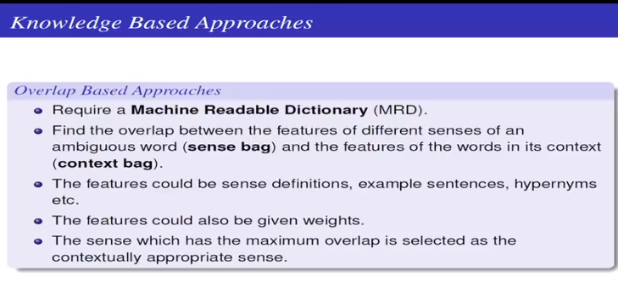

Slide 73
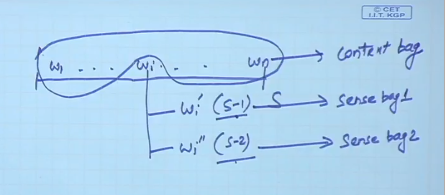

Slide 74
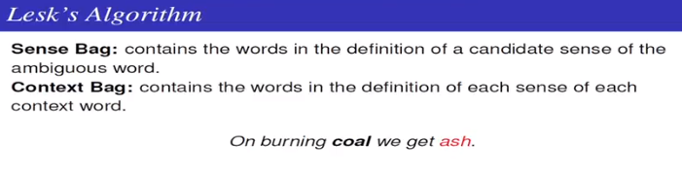
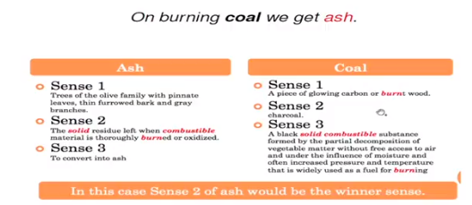

Slide 75
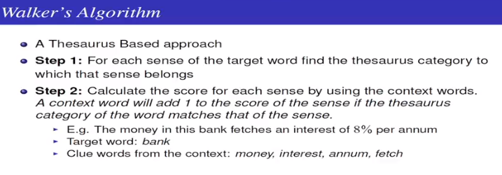
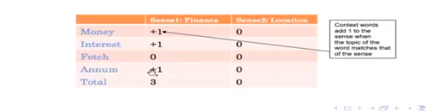

Slide 76
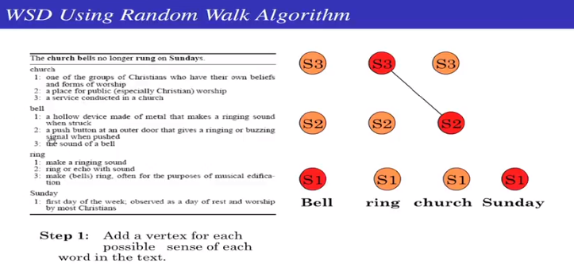

Slide 77
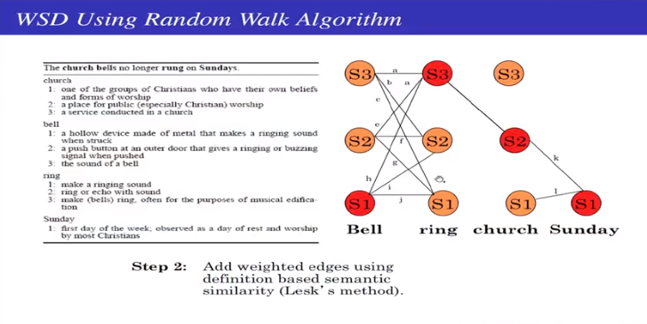

Slide 78
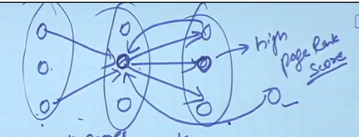

Slide 79
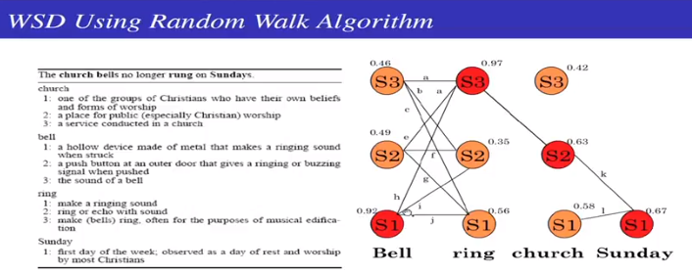
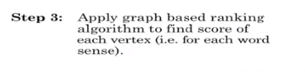

Slide 80
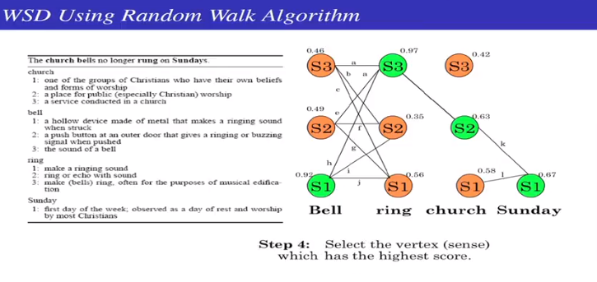

Slide 81
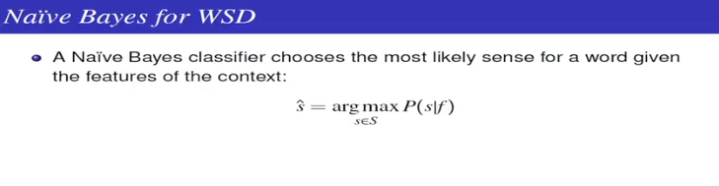
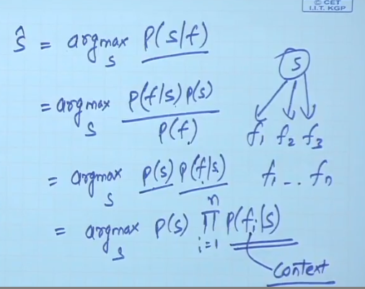

Slide 82
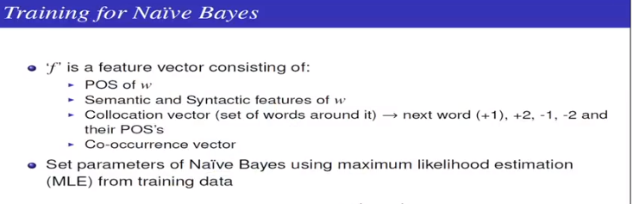
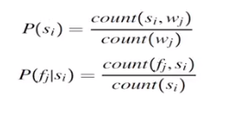

Slide 83
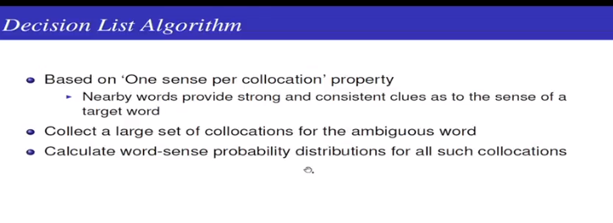
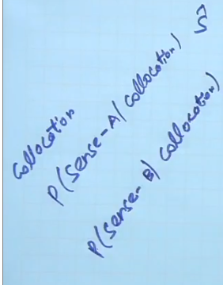

Slide 84
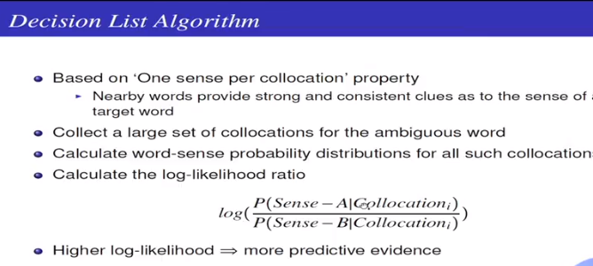

Slide 85
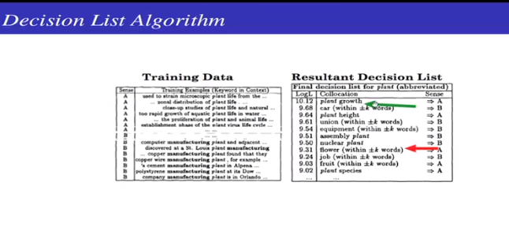
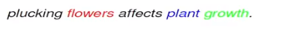

Slide 86
